Slide 1


Mental health & Support at Ashton Sixth Form

Slide 2
We all have Mental Health in the same way we all have Physical Health.
Now for a short video:
https://www.youtube.com/watch?v=DxIDKZHW3-E
Notes:
Maintaining a positive sense of self at Ashton – different facets that can help.

Slide 3
Positive Wellbeing
Purpose
Relationships
Enjoyment
Control
Notes:
Maintaining a positive sense of self at Ashton – different facets that can help.

Slide 4

Social, Emotional
& Mental Health
Notes:
SEMH – define. Emotional health means being in control of thoughts, feelings and behaviours. Mental health refers to our ability to process thoughts, feelings and emotions. Scale – spectrum, we can move along it (good days/bad days cliché) but ideally for the most part will be near to top left.

Slide 5
The Adolescent journey
moving from childhood to adulthood
Emotional
Physical
Social
Identity
Notes:
Impact of Covid – inevitable challenges.

Slide 6
Promoting Positive SEMH
Good physical health – diet and exercise.
Community – join in.
Positive interpersonal relationships.
Coping with stress, change & uncertainty.
Honesty – knowing when to seek help.

Slide 7
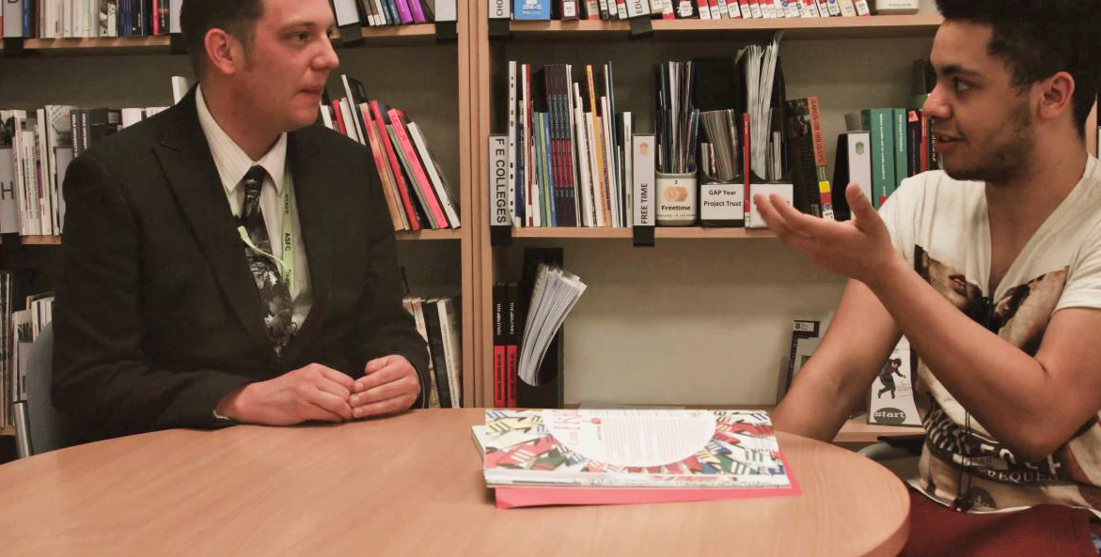




Sometimes, help is needed
Notes:
Role of the Tutor. Internal support – college counselling and Inclusive Learning. External agency support who come in to the college inc. 42 St & NHS (CBT)

Slide 8
College Counsellors at Ashton
Many years experience working with young people
Increase in recent years of the amount students using the counselling services
Appointments are made either on request or by referral (usually through Senior Tutor)
Counselling box for slips outside counselling room
Email directly to: counsellors@asfc.ac.uk

Slide 9
How do people use
the counselling service?
Some students visit regularly and have weekly appointments
Some students visit once and that may be enough for them
Some students may have more complex needs and a referral to an external agency maybe required
It all depends on the student and their needs
Students at serious risk – professional obligation this is shared

Slide 10
Thank you

