Slide 1
So What is Sixth Form?
Chris Cox – Vice Principal
Sept 24

Slide 2
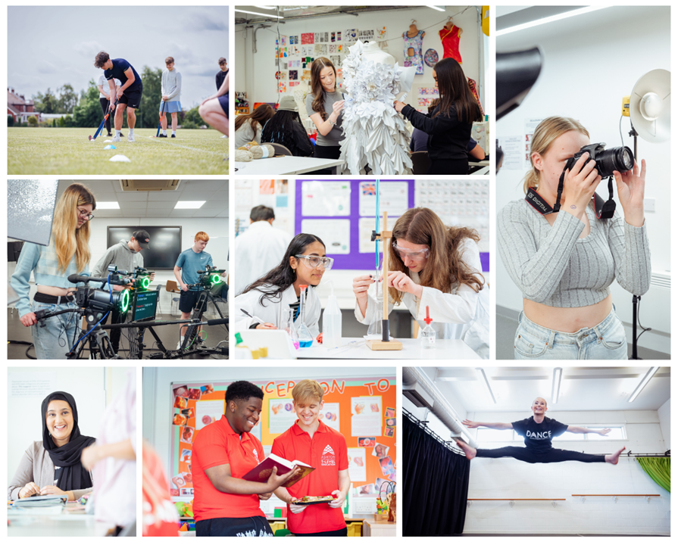
Information we have already given to your sons and daughters over the past couple of weeks, and messages they will be given shortly…

Slide 3
Sixth Form
Wider World
(University, employment, career)
High School

Slide 5
Level 3 / Sixth Form is a step up
…but it’s a step they are all ready for, and it’s what we specialise in!

Slide 6
It might not always be like this, though…
Nothing worth having comes easy!

Slide 7
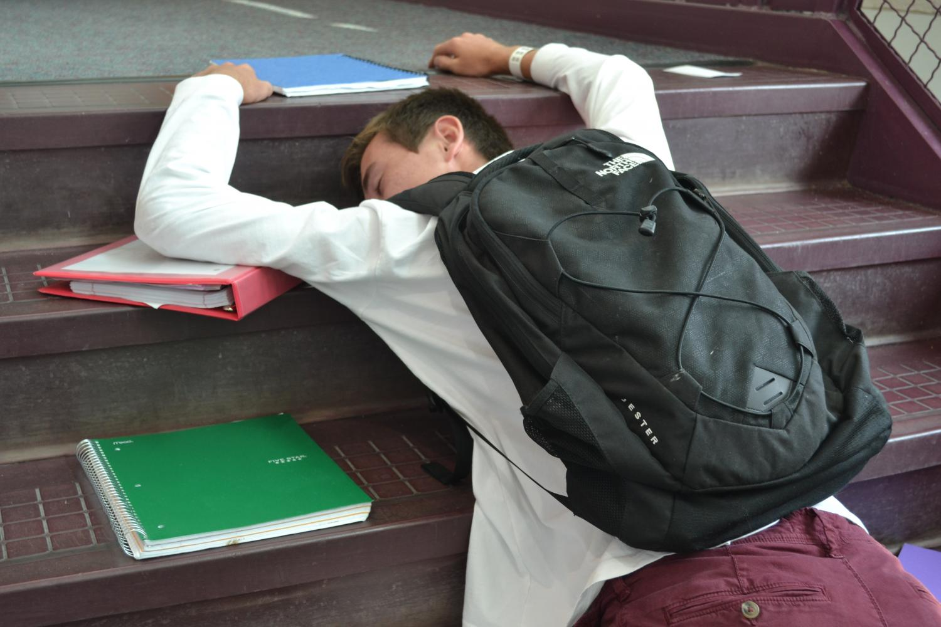
But please don’t let them get to this point…
There’s lots of help and support to steer students through tricky moments…

Slide 8
Support Services at ASFC
Senior Tutors & Tutorials
Study+
Learning Resource Centres
Multi faith Chaplaincy
Bursary/FSM
Bursary/ Attendance Officer
CEIAG
Wellbeing Support
Inclusive Learning

Slide 9
Study Programme
This is the collection of their courses, tutorial, support/1:1s (Study +), work experience and any ‘extras’ that are planned and timetabled for them.
It is bespoke to each student; to suit their aspirations, skills and prior achievement.
All aspects of their study programme are important and they must attend and put effort into all aspects.
Full attendance is the route to success!

Slide 10
Attendance and High Grades are Inextricably Linked

Slide 11
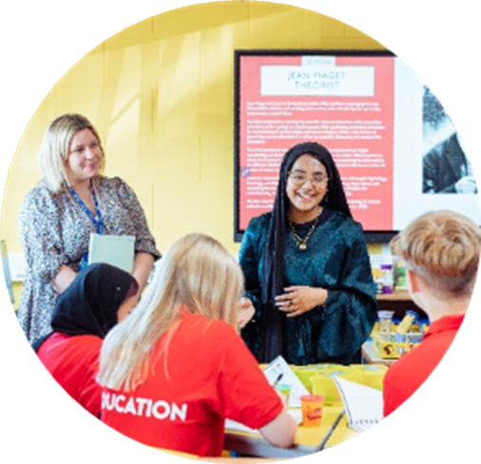
They’re only learning when they’re here…
E means - explained absence but is a negative mark
A means assessment/exam but is a positive mark
Marks for study leave, placement etc. will count positively

Slide 12
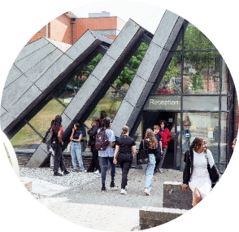
Sixth form is an amazing experience we hope they really enjoy it!
Academically – they have chosen courses they will enjoy and thrive on.
Sixth form is where many students find their area of passion and find that it is possible to achieve at a better level than ever before.
Wider opportunities – lots of enrichment, both in subject and cross-college.
Socially – they will leave ASFC with lifelong friends they have not even met yet!
This is the only time of their life that they are exclusively around people of their own age…. 2,300 of them!

