Slide 1
The Oxbridge/MDV Application Process
Dr. Damian Windle
Head of The XL Academy

Slide 2
Why Oxbridge?
https://youtu.be/LlCwHnp3kL4

Slide 3
What’s the big deal?
‘The two institutions are the most competitive to gain access to in the UK; regularly appear in first and second position in league tables and are often at or near the top of worldwide rankings. Additionally, graduates from Oxbridge dominate public life in the UK. Almost half of the current cabinet were educated at Oxbridge (compared to 35% educated at one of the 22 other Russell Group universities) as were 24% of the MPs elected in 2017 (compared to 30% at other Russell Group institutions). Across several other leading professions, Oxbridge also dominates; 78% of top barristers, 54% of prominent journalists and 51% of senior civil servants were educated at one of the two universities.’ Sutton Trust 2018

Slide 4
What makes Oxford and Cambridge such special universities?
The collegiate system
Teaching and tutorials
Time and space to be at the top of your game

Slide 5
Separating the myths….
Intake, Interview, Finance…
In truth Oxford and Cambridge Universities:
Seek to attract the best and brightest applicants regardless of background, which they seek out via extensive access programmes across the UK, as well as visits overseas.
Have highly rigorous and fair application procedures designed to allow the very best candidates to shine; and
Are diverse and vibrant places to live and study.

Slide 6
Therefore…
Expect the process to be very hard
Expect the process to be brutal
Be prepared for your son/daughter to work the hardest they’ve ever worked
Expect that only roughly 1 in 5 students will get a place*
But….
Expect the process to be fair
Expect a first class level of support
Expect extra benefits from being part of the process

Slide 7
Is Oxbridge for your son/daughter?
The most important thing is the degree they wish to study – they need to be passionate about it
Oxford and Cambridge tend to be traditional academic courses – strong emphasis on personalised teaching – often 100% based on examinations
Students need to be able to motivate themselves, good at independent working and mentally tough
Don’t believe the myth – Oxbridge is a for state school Northern students

Slide 8
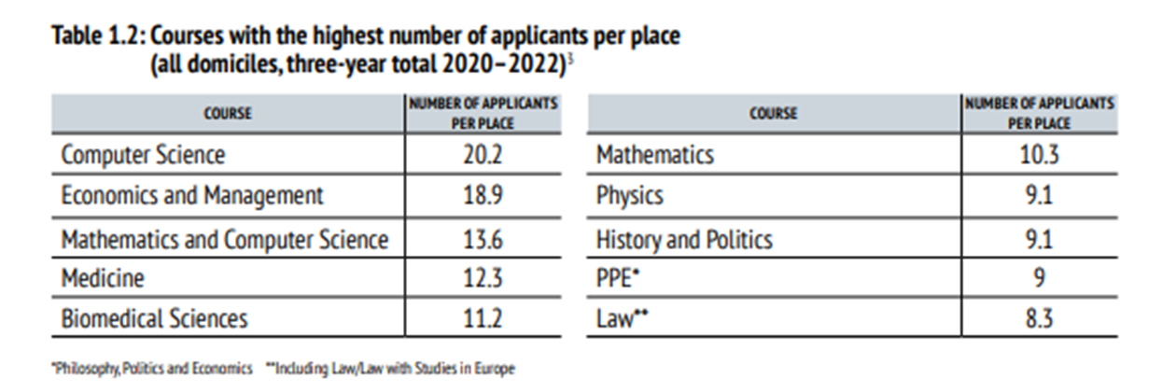
Entrance Requirements
Typical offer:
A-level – A*A*A - AAA
GCSEs – at least 7x7’s but average is around 7x8’s (average point score of around 7.3)
Entry criteria are purely academic
Emphasis is on potential
Between 1/5 and 1/6 success rate

Slide 9
Choosing between Oxford and Cambridge
Not possible to apply for both
Some courses are offered at one and not the other. Important to check that courses with the same title may have different content

Slide 10
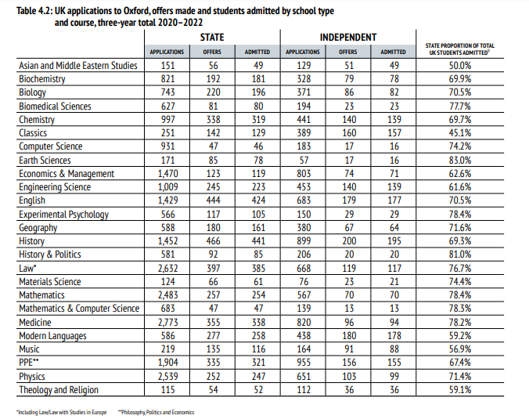
Oxford by subject

Slide 11
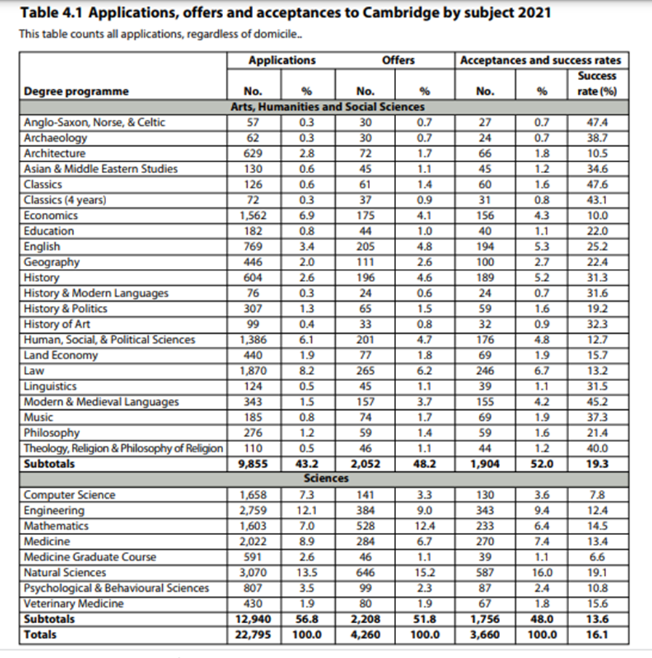
Cambridge by subject

Slide 12
Academic Life
Tutorials / Supervisions – on a small group basis
Lectures
Classes
Laboratory work and fieldwork
Experienced Tutors
Independent learning
Provision of world-class resources

Slide 13
College Life
29 at Oxford - 25 at Cambridge
College is primarily where students live
Student rooms Tutors’ studies
Library Computer Facilities
Dining Hall Common room
Sports facilities Music facilities
College Students’ Union
Base for the core tutorial teaching
Most colleges offer places for most subjects

Slide 14
Choosing a College
Specify a College or make an ‘Open’ application
Colleges have more similarities than differences
Roughly 24% of successful applicants are made offers by a different College to the one that they originally applied
Factors to consider:
  Check the college offers your subject
  Size
  Style
  Location
  Accommodation
  Specific facilities
Good for parents/guardians to be involved and get ‘buy in’

Slide 15
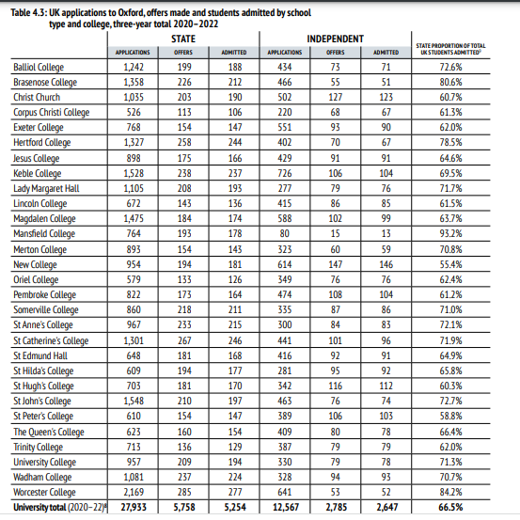
Oxford by college

Slide 16
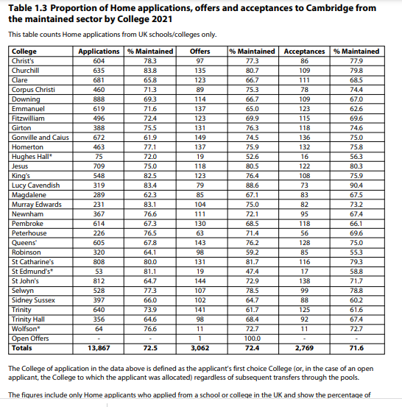
Cambridge by college

Slide 17
The Oxbridge Application process – what admissions tutors consider
Predicted A level grades
GCSE results
UCAS personal statement
UCAS reference
Written tests (where required)
Written work (where required)
Interviews

Slide 18
Oxbridge Personal Statement
Content: Wider Reading, Wider Reading, Wider Reading
80 % – academic
20% – all other aspects of student
Style:
  Concise
  Honest
  Clear
  Being Academic
  Thinking about ‘Springboards’
When a student puts something down, they need to ‘use’ it.

Slide 19
Admissions Tests
Extra tests for many subjects during October
Individual Student is responsible for entering
Will be the hardest tests they’ve ever done
Examples online

Slide 20
Admissions Tests
Oxford Admissions Test
Cambridge Admissions Test
Ancient History and Classical Archaeology Admissions Test (AHCAAT) - NEW for 2024
Biomedical Sciences Admissions Test (BMSAT) – NEW for 2024
Classics Admissions Test (CAT)
History Admissions Test (HAT)
Mathematics Admissions Test (MAT)
Modern Languages Admissions Test (MLAT)
Philosophy Test (PhilAT)
Physics Admissions test for Physics, Engineering and Materials Science (PAT)
Thinking Skills Assessment (TSA)
LAW – LNAT
Medicine - UCAT
https://www.ox.ac.uk/admissions/undergraduate/applying-to-oxford/guide/admissions-tests
Chemical Engineering and Biotechnology - ESAT
Engineering - ESAT
Natural Sciences -ESAT
Veterinary Medicine – ESAT
Law – LNAT
Medicine – UCAT
Maths - TMUA
https://www.undergraduate.study.cam.ac.uk/apply/how/admission-tests

Slide 21
How to register
Oxford
Cambridge
https://home.pearsonvue.com/About/News/2024/The-University-of-Oxford-appoints-Pearson-VUE.aspx
https://esat-tmua.ac.uk/
All applicants must register from 1st August up until 15th September
Test date approximately 15th October
No charge for Oxford, £75 for Cambridge – Reimbursed

Slide 22
Interviews
Last between 20-40 minutes normally
2-3 tutors can be present
More than one interview
May be in person/online
May have interviews at other Colleges
Nearly entirely academic in focus
Students should be prepared
Designed to see how you think and what you do in certain situations – not necessarily about getting the answer ‘right’
All Oxbridge students receive interview support and mocks

Slide 23

What are they looking for?

Slide 24
How do students apply?
Begins now! Open days
Admissions Registration Register from 1st August
Personal statement Internal Deadline 30th September
UCAS form sent 15th October
Admissions Test Mid-October
Written work Mid - November
(Written tests at interview for other subjects)
Interviews Early - Mid December
Decisions and Offers Early January

Slide 25
What do students need to do?
Work out if it might be right for them
Think about wider experience
Think about wider reading
Maintain focus on grades

Slide 26
How can parents support
Understand the process and support each stage
Understand that the journey has lonely times and students need reassurance and confidence
Help with time management and decision making – work hard, play hard mentality
Have a good overview of mental health
Bring realism and sense of perspective – it will be a bumpy ride
Communicate with college

Slide 27

Medicine/Dentistry/
Vet science
Process

Slide 28
Encouraging your son/daughter
Don’t believe the headlines
It is an exhilarating, academic and practical profession
Every day is different
Incredibly challenging
Incredibly rewarding

Slide 29
Is it right for your son/daughter?
Only 1 in 5 of applicants are successful
Good pay but…
Long antisocial hours
Treadmill of exams
Hospitals can be difficult places
Talking to your son/daughter about different careers

Slide 30
Grades
Typical A-Level Offer is A*AA – AAA therefore grades matter
GCSE’s also need to be good too – check English and Maths scores
They need to be getting consistently good grades in all their assessments

Slide 31
Work Experience
They must have several work experiences
Ideally one in a clinical setting e.g. hospital, GP surgery, volunteering at Tameside
One ‘regular’ placement – hospice, care home, charity shop, pharmacy
Other experiences are also good e.g. Summer schools etc
Vets – different settings – large animal, small animal, livestock, abattoir etc
Dentists – ideally 3 weeks experience and online as well e.g. Discover Dentistry

Slide 32
Things that they should be doing on placement
Impeccable behaviour, punctuality, attendance
Asking questions
Undertaking any task
Observing the attributes of a doctor, interaction, the tasks they carry out, interventions carried out, importance of multi-disciplinary team
Keeping a journal!

Slide 33
Virtual Work Experience
Observe GP: https://www.rcgp.org.uk/training-exams/discover-general-practice/observe-gp.aspx
Virtual Work Experience Platform: https://bsmsoutreach.thinkific.com/collections
Medic Mentor: https://medicmentor.co.uk/
Manchester Outreach Medics https://www.manchesteroutreachmedics.com/

Slide 34
Researching universities – choosing a medical school
Teaching Styles
- Traditional, integrated, PBL
League tables
Factors to consider – Grades, Interviews, Location, Course structure, Teaching style, electives

Slide 35
Rankings
https://www.thecompleteuniversityguide.co.uk/league-tables/rankings/medicine?tabletype=full-table
https://www.thecompleteuniversityguide.co.uk/league-tables/rankings/dentistry
https://www.thecompleteuniversityguide.co.uk/league-tables/rankings/veterinary-medicine

Slide 36
Testing
Will need to sit the UCAT (Medics and Dentists) exam – students book this. Book in June for a September test. Needed for 29 universities
It is very important to get a decent average

Slide 37
How the UCAT works
Cognitive Subtests | Questions | Scale Score Range | Marking
Verbal Reasoning | 44 | 300 - 900 | Questions are worth 1 mark each.
Decision Making | 29 | 300 - 900 | Single answer questions are worth 1 mark. Multiple statement questions are worth 2 marks. 1 mark is awarded to partially correct responses on the multiple-statement questions.
Quantitative Reasoning | 36 | 300 - 900 | Questions are worth 1 mark each.
Abstract Reasoning | 50 | 300 - 900 | Questions are worth 1 mark each.
The total scaled score ranges from 1200 to 3600.
converted to scaled scores that share a common range from 300 to 900.

Slide 38
Situational Judgement
Situational Judgement Scoring
Within the Situational Judgement Test, full marks are awarded for a question if your response matches the correct answer and partial marks awarded if your response is close to the correct answer.
Scores for the Situational Judgement Test are expressed in one of four bands, with band 1 being the highest. Alongside your band, you are given an interpretation of your performance:
As the Situational Judgement test is a measure of non-cognitive attributes, it will be considered by universities in a different
Band 1 | Those in Band 1 demonstrated an excellent level of performance, showing similar judgement in most cases to the panel of experts.
Band 2 | Those in Band 2 demonstrated a good, solid level of performance, showing appropriate judgement frequently, with many responses matching model answers.
Band 3 | Those in Band 3 demonstrated a modest level of performance, with appropriate judgement shown for some questions and substantial differences from ideal responses for others.
Band 4 | The performance of those in Band 4 was low, with judgement tending to differ substantially from ideal responses in many cases.

Slide 39
Timings (UCAT)
Subtest | Questions | Timing
Verbal reasoning | 44 | 21 minutes
Decision making | 29 | 31 minutes
Quantitative reasoning | 36 | 25 minutes
Abstract reasoning | 50 | 12 minutes
Situational judgement | 69 | 26 minutes
Total Time |  | 115 minutes*
* Each subtest is preceded by a 1 minute instruction section.

Slide 40
Med Schools and cut off scores
Students need to check which is most appropriate for their score
UCAT cut-off scores: https://www.themedicportal.com/application-guide/ucat/ucat-universities/?v=79cba1185463
There is no point applying if they don’t meet the criteria
Need to consider their average and your situational judgement (some will not accept Band 4)
Manchester 2750, Band1/2, Liverpool 2620, Keele 2250

Slide 41
Online help
Entry requirements for each med school https://www.medschools.ac.uk/media/2032/msc-entry-requirements-for-uk-medical-schools.pdf
Gaining experience in the time of Coronavirus https://www.medschools.ac.uk/media/2636/guidance-on-gaining-relevant-experience-for-studying-medicine-in-the-time-of-covid-19.pdf
New website with some good comparison tables https://www.scrubbed-up.com/ultimate-guide-to-uk-medical-school
UCAT tips https://www.scrubbed-up.com/post/ucat-exam-tips
BMAT tips https://www.scrubbed-up.com/post/bmat-top-tips
Information on the UCAT https://www.kaptest.co.uk/ucat/infoUCAT
how to register https://www.ucat.ac.uk/ucat/registration-booking/
Applying to Medicine https://www.medschools.ac.uk/media/2951/entry-requirements-document-2023-entry.pdf
Applying to Dentistry https://www.dentalschoolscouncil.ac.uk/studying-dentistry/making-an-application/
Applying to Vet medicine https://www.vetschoolscouncil.ac.uk/study-and-training/applications/
https://www.bva.co.uk/your-career/becoming-a-vet/

Slide 42
Interviews
Most probably be MMI
Lots of practice at college.

Slide 43
How can parents support
Understand the process and support each stage
Understand that the journey has lonely times and students need reassurance and confidence
Help with time management and decision making – work hard, play hard mentality
Have a good overview of mental health
Bring realism and sense of perspective – it will be a bumpy ride
Communicate with college

Slide 44
Any Questions?
Dr. Damian Windle – dwi@asfc.ac.uk
Head of The XL Academy

