Slide 1


Curriculum and Planning
Sheridan Lewis – Vice Principal
Sept 24

Slide 2
A1 Students’ Term Dates 2024-2025
Start of teaching – Thursday 5th September 2024
Autumn half term holiday – Mon 21st – Sun 3rd November
End of Autumn Term – Friday 20th December
Start of Spring Term – Tuesday 7th January 2025
Spring half term holiday – Mon 17th – Sun 23rd February
End of Spring Term – Friday 4th April
Start of Summer Term – Tuesday 22nd April
Summer half term holiday – Mon 26th May – Sun 1st June
A1s’ last day - Friday 4th July

Slide 3
Overview of the Year…
35 teaching weeks
70 minute lessons
4 periods per A level or BTEC Cert, 12 periods for Ext Dips, 16 periods for Football Coaching and 15 periods for T-Levels, plus 2 periods of tutorial with their Tutor each week
4 days a week in College plus a Study Day
Key component of success is work done outside of the classroom, independent study and work at home
Parents/Carers can monitor attendance and achievement through Cedar and contact with Senior Tutors

Slide 4
A Level/Mixed Study Timetable
Period | Start | End | Mon | Tue | Wed | Thu | Fri
1 | 09:00 | 10:10 | Psychology | Study Period | Study Day | Drama | Study Period
Break 10:10 – 10:30
2 | 10:30 | 11:40 | Drama | Law Cert |  | Study Period | Psychology
3 | 11:40 | 12:50 | Study Period | Tutorial |  | Law Cert | Drama
A Level/Mixed Study lunch 12:50 – 13:40
4 | 13:40 | 14:50 | Law Cert | Psychology | Study Day | 1to1 Period | Study Period
5 | 14:50 | 16:00 | Study Period | Drama |  | Psychology | Law Cert
Study Day |  |  |  |  | A1 (mixed)

Slide 5
Level 3 Vocational Timetable
Period | Start | End | Mon | Tue | Wed | Thu | Fri
1 | 09:00 | 10:10 | Business | Study Period | Business | Study Day | Business
Break 10:10 – 10:30
2 | 10:30 | 11:40 | GCSE English | Business | Business |  | 1to1 Period
Vocational lunch 11:40 – 12:30
3 | 12:30 | 13:40 | Business | Business | Study Period | Study Day | GCSE English
4 | 13:40 | 14:50 | Tutorial | Business | GCSE English |  | Business
5 | 14:50 | 16:00 | Business | GCSE English | Business |  | Business
Study Day |  |  |  |  |  | A1 Voc

Slide 6
Target setting…
what we will be telling your sons and daughters…

Slide 7
Our main focus is progress…
Measured from their starting point
This starting point is likely to be different to that of the person they are sat next to
At Ashton Sixth Form College, we use the GCSE score as the starting point
The system we use is called ‘ALPS’ (A-Level Performance System) – used for all qualifications

Slide 8
Focusing on progress:
Minimum Expected Grades (MEGs)
Current Working at Grades (WAGs)
MEG – the lowest grade they should achieve, but we want and expect them to aim higher
Working at Grade – the grade they have achieved in the latest assessment

Slide 9
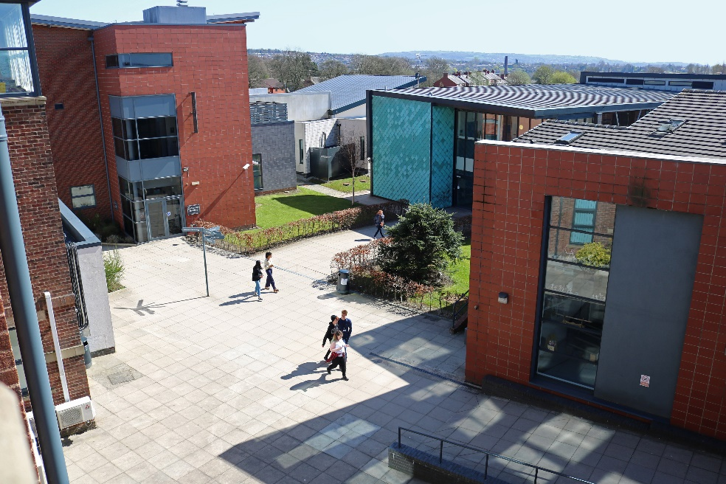
How we track progress…
4 Formal Assessment points this year
A-level - timed, standardised in-class tests; the third one is a mock exam to assess the learning and progress in A1
Vocational/Art students… teachers will use all work to date to assess the current working at grade (WAG)
Students must do their best, then we know if additional support is needed
Parents will get to see these grades
Don’t worry if grades are a little up and down in A1 – that’s normal

Slide 10
How will students know how they are doing?
There will be regular assessments in all subjects, but each half term from November onwards, one major assessment will take place under timed conditions
Results from these will be available to parents/carers, and students will work with their teachers on improvements
Formal Assessment 1 – W/C 11th November and W/C 18th November
Formal Assessment 2 – W/C 27th January and W/C 3rd February
Formal Assessment 3 – W/C 28th April (Mock 1 – all week with study leave)
Formal Assessment 4 – W/C 9th June 2025
After each formal assessment, students and parents will be given the currently working at grade, WAG.
The April mock exam will inform progression to A2, and UCAS predictions (although predictions are based on a holistic judgement of your performance).

Slide 11
Rhythm of the year - A Level
FA 1
FA 2
FA 3
FA 4
28th April
Mock 1
with study leave
Nov 11th + 18th
Jan 27th + Feb 3rd
June 9th

Slide 12
Rhythm of the year – BTEC/Vocational
WAG
WAG
WAG
WAG
Nov - ongoing assignments
and assessments
Jan - exams and ongoing assessments
March onwards BTEC set tasks and assessments
April to June
BTEC set tasks and completion of units

Slide 13
Rhythm of the year - Criminology
FA 1
FA 2
Unit 2 Exam
Unit 1 Exam
FA 3
External exam -
controlled assessment w/c June 23rd
28th April
Mock 1
with study leave
External exam May - date tbc
Nov 11th + 18th
Jan 27th + Feb 3rd

Slide 14
Parents’/Carers’ Evenings…
Thursday 27th February and Wednesday 5th March
Online appointments through SchoolCloud
Information and guidance for making appointments will be sent out in January
A1 end of year reports sent out Wednesday 9th July, with 3 targets for summer/starting A2 work
College calendar with key dates available on website
(Parents/carers will receive an email, please fill in trips+ visit form and check your contact details are correct)

Slide 15

Parent/Carer Essentials
Home page
Communication
Creating Cedar Parental Accounts
If you are unsure how to create a Cedar parent/carer account we have a quick guide available on the website
Once created, enter the email address that we have on the system for you and the student reference, this is your son/daughter’s student ID no. it can be found on their ID badge
It is the last 6 digits of the long number. Put a P in-front of it to take you to the parent / carer account. The password will be the one you have created
We must have your personal email (rather than a work email) on the system to be able to create an account
Once logged into Cedar you will be able to see your son / daughter’s:
Timetable
Pastoral log – including commendations
Formal assessment point grades
Attendance record
Upcoming exam timetables (including mock exams)
You are able to email your son / daughter’s Senior Tutors and teachers which will enable you to communicate directly with them
Update contact/medical details
Careers log
Any active surveys
https://cedar.asfc.ac.uk/auth/account/create

Slide 16
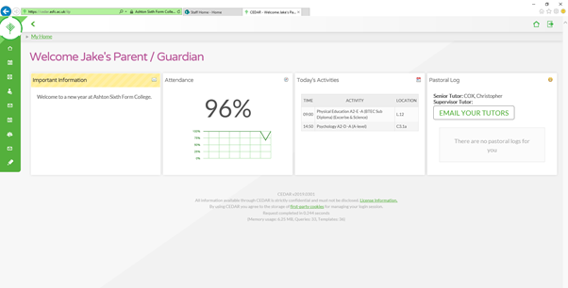

Slide 17
A precious two years…. let’s get the most from it!

Slide 18
Thank You!

