Slide 1

Curriculum and Planning
Sheridan Lewis – Vice Principal
Sept 25

Slide 2
Overview of the year
35 teaching weeks
70 minute lessons
4 periods for A level or BTEC Certificate, 12 periods for Extended Diplomas, 16 periods for Football Coaching and 15 periods for T-Levels, plus 2 periods of tutorial with their Tutor each week
4 days a week in College plus a Study Day – this will be used
Key component of success is work done outside of the classroom, independent study, study day and work at home
Parents/Carers can monitor attendance and achievement through Cedar and contact with Senior Tutors

Slide 3
A1 Students’ Term Dates 2025-26
Start of teaching – Thursday 4th September 2025
Autumn half term holiday – Mon 20th October – Sun 2nd November
End of Autumn Term – Friday 19th December
Start of Spring Term – Tuesday 6th January 2026
Spring half term holiday – Mon 16th – Sun 22nd February
End of Spring Term – Friday 27th March
Start of Summer Term – Monday 13th April
Summer half term holiday – Mon 25th – Sun 31st May
A1s last day – Tuesday 30th June

Slide 4
How does the day look
Period | Start | End
Period 1 | 9am | 10:10am
Break | 10:10am | 10:30am
Period 2 | 10:30am | 11:40am
A1 Lunchtime (Period 3a) | 11:40am | 12:30pm
Period 3v | 12:30pm | 1:40pm
Period 4 | 1:40pm | 2:50pm
Period 5 | 2:50pm | 4pm

Slide 5
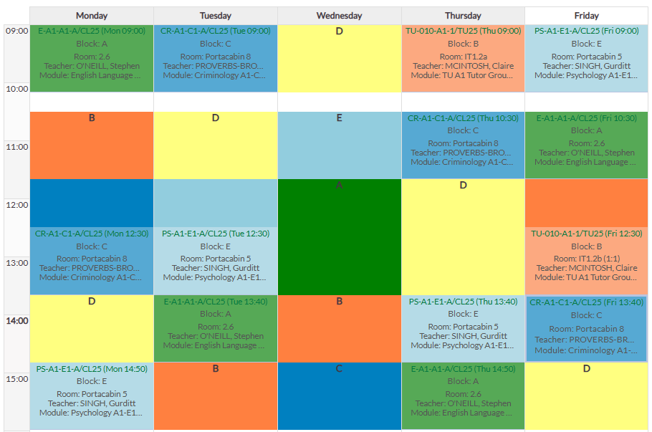
A-Level/Mixed study programme

Slide 6
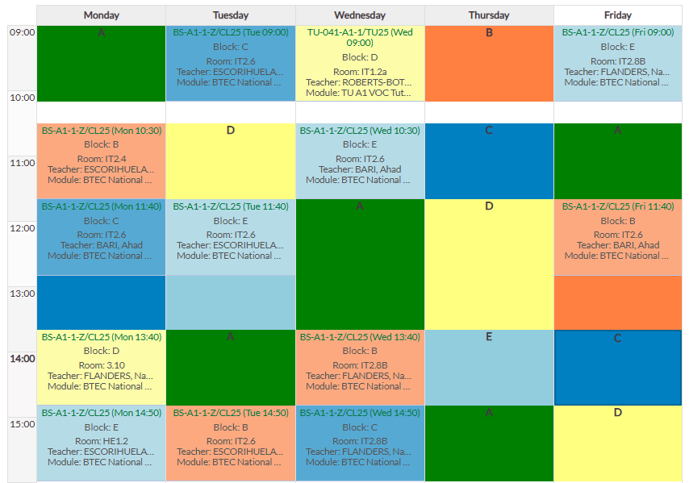
Full time Vocational study programme

Slide 7
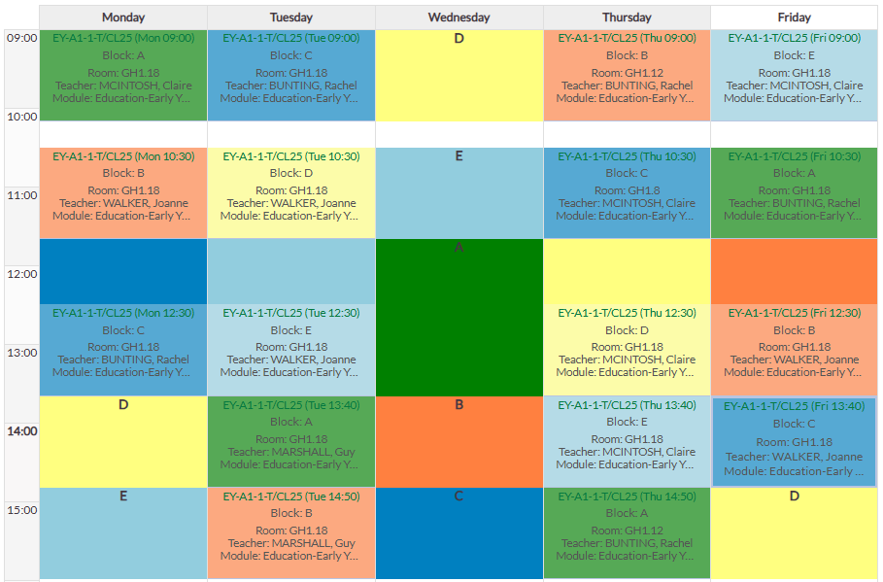
T Level study programme

Slide 8
Target setting
what we will be telling your sons and daughters…

Slide 9
We focus on progress
Students are measured from their starting point
This starting point is likely to be different to that of the person they are sat next to
Colleges use the average GCSE score as the starting point to set targets (any GCSE re-marks let us know)
The system we use is called ‘ALPS’ (A-Level Performance System) – used for all qualifications

Slide 10
Focusing on progress:
Minimum Expected Grades (MEGs)
College Assessment Points (CAPs)
Current Working at Grades (WAGs)
MEG – the lowest grade they should achieve, but we want and expect them to aim higher
CAPs – 5 College Assessments Points in A1
Working at Grade – the grade they have achieved in the latest assessment

Slide 11
How we track progress
A-level/mixed prog - standardised in-class tests; with a mock exam in April to assess learning and progress in A1
Full time Vocational and Art students… teachers will use all work to date to assess the current working at grade (WAG)
Parents see these grades on Cedar
Students must do their best, then we know if additional support is needed
Early CAPs focus on building skills and confidence
Assessment schedules have been issued with revision topics and support materials
Students may be directed to Subject+ or Study+ if support is needed
Don’t worry if grades are a little up and down in A1, that’s normal

Slide 12
A1 College Assessment Points (CAPs)
College Assessment Point | Week Commencing
CAP 1 | 6th October
CAP 2 | 24th November
CAP 3 | 2nd February
CAP 4 (Mock 1) | 20th April
CAP 5 | 8th June

Slide 13
Rhythm of the year - A Level/Mixed Prog
CAP 1
CAP 2
CAP 3
CAP 4
CAP 5
20th April
Mock 1
with study leave
w/b 6th Oct
w/b 24th Nov
w/b 2nd Feb
w/b 8th June

Slide 14
Rhythm of the year – BTEC/Vocational
WAG
WAG
WAG
WAG
WAG
Oct - ongoing assignments
and assessments
Nov - ongoing assignments and assessments
Jan/Feb - ongoing assignments
and assessments
March onwards BTEC set tasks and assessments
April to June
BTEC set tasks and completion of units

Slide 15
Rhythm of the year - Criminology
CAP 1
CAP 2
CAP 3
Unit 1 Exam
Unit 2 Exam
External exam in May and 20th April
Mock 1
with study leave
External exam -
controlled assessment w/b
22nd June
w/b 6th Oct
w/b 24th Nov
w/b 2nd Feb

Slide 16
Parents’/Carers’ Evening
Wednesday 21st and Thursday 29th January
Online appointments through SchoolCloud
Information and guidance for making appointments will be sent out in January
A1 end of year reports sent out Wednesday 8th July, with 3 targets for summer/starting A2 work
College calendar with key dates is available on website
Parents/carers will receive an email with a Google form to fill in trips + visit form and check your contact details are correct

Slide 17

Parent/Carer Essentials
Home page
Communication
Creating Cedar Parental Accounts
If you are unsure how to create a Cedar parent/carer account we have a quick guide available on the website
Once created, enter the email address that we have registered at college for you and the student’s reference number, this is your son/daughter’s student ID number
The number can be found on their ID badge. It is the last 6 digits of the long number. The password will be the one you have created
We must have your personal email (rather than a work email) on the system to be able to create an account
Once logged into Cedar you will be able to see your son / daughter’s:
Timetable
Pastoral log – including commendations
College assessment point grades
Attendance record
Upcoming exam timetables (including mock exams)
You are able to email your son / daughter’s Senior Tutors and teachers which will enable you to communicate directly with them
Update contact/medical details
Careers log
Any active surveys
https://cedar.asfc.ac.uk/auth/account/create

Slide 18
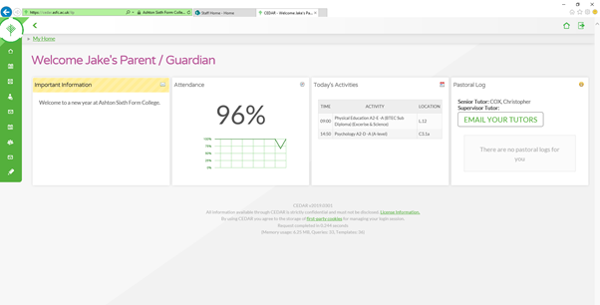

Slide 19
A precious two years…. let’s get the most from it!

Slide 20
Thank You!

