Slide 1
A-Level Study Skills
A Parents Guide

Slide 2
Key Dates:
December Mock Week: Friday 6th December
March Mock Week: Friday 14th March
Message to students: Treat these like the real exams!
Summer Examination Series usually begins in May
Revision should start 3 months before each series of exams
Notes:
Dec mocks are Fri 8th Dec to Fri 15th Dec
March mocks are Fri 8th March - Fri 15th March

Slide 3
What can you do to help?
Engaging with senior tutors and teachers regularly:
Email/Cedar/Phone call
Parents evening
Departments may email newsletters/useful information with key dates and enrichment activities
Engagement with the college calendar:
Assessment, Mock and Controlled Assessment dates
Personal Statement deadlines
Student
Teacher/
Tutor
Parent

Slide 4
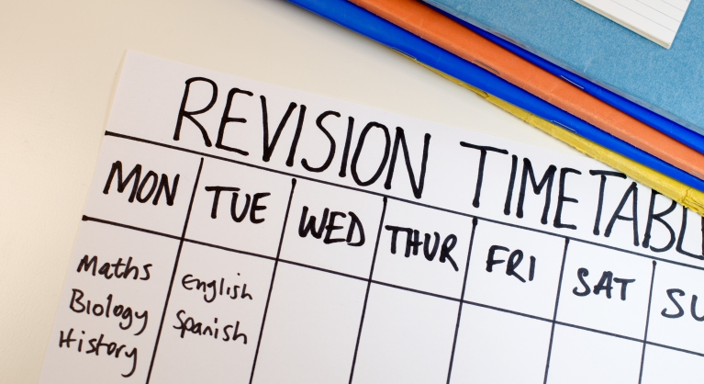
What can you do to help?
Revision:
Students can often find revision difficult.
When we read information we can convince ourselves that we know it but this is often simply because we are recognising information rather than remembering it.
Quizzing students on key terms regularly or asking them to explain theories in their own words can really aid recall and understanding
A-level study should be treated like a 9-5 job

Slide 5
Example Revision Tasks
Examples of stage 1 revision techniques (Understanding & Remembering) | Examples of stage 2 revision techniques (Practising how to use information)
Summary cards​ Mind-maps​ Glossary of terms Essay planning sheets​ Link the specification to the content using the summary table​ Online apps like Quizlet/Kahoot Make your own podcasts​ Activity sheets - do them again! | Have another go at the questions we have tried in your workbooks ​ Have a go at the questions from the past papers on exam board websites OR from the Past paper pack Understand how to tackle the different types of questions​ Practice the different types of questions

Slide 6
Good habits of an A-Level student
Organisation: Class notes, files, revision materials
Work hours: 8-10 hours per week
Routines: Are free periods/study days being utilised?
Revision: Revise to a timetable with quality resources
Attendance: Make excellent attendance a priority

Slide 7
Student “1” and Student “2”
“1” (MEG: B) | “2” (MEG: B)
Attendance: 99% (no lates) Class Assessments: All Completed Average Grade: D Year 1 Progression Grade = C Mock results: B/C Overall A-level Grade: A Needed B for next steps | Attendance: 90% (some lates) Class Assessments: All completed Average Grade: C Year 1 Progression Grade: D Mock results: D/C Overall A-level Grade: C Needed B for next steps

Slide 8
Questions?

